Slide 1
Operational Amplifier - Differential Amplifier
A combination of the inverting and noninverting amplifiers; it finds frequent use in situations where the difference between two signals needs to be amplified.
The basic differential amplifier circuit - the two sources v1 and v2 may be independent of each other or may originate from the same process.

Slide 2
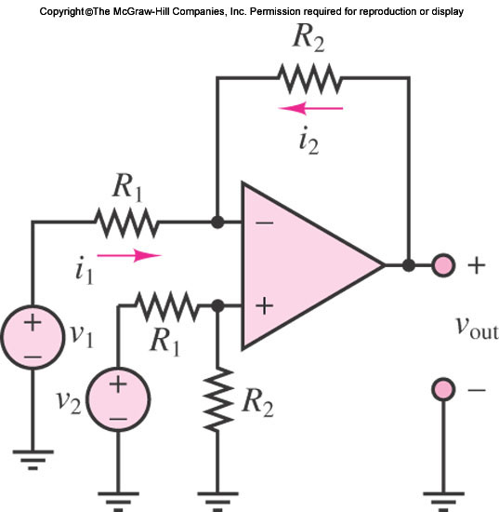
Operational Amplifier - Differential Amplifier
The basic differential amplifier circuit - the two sources v1 and v2 may be independent of each other or may originate from the same process.

Slide 3

Operational Amplifier - Differential Amplifier
The analysis of the differential amplifier is approached by various methods; the one we select to use at this stage consists of

Slide 4

Operational Amplifier - Differential Amplifier
Since it has been assumed that no current flows into the amplifier, the noninverting terminal voltage is given by the following voltage divider:

Slide 5


Operational Amplifier - Differential Amplifier
If the inverting-terminal voltage is assumed equal to v+, then the currents i1 and i2 are found to be

Slide 6

Operational Amplifier - Differential Amplifier
and since
The following expression for the output voltage is obtained:

Slide 7
Operational Amplifier - Differential Amplifier
The differential amplifier magnifies the difference btw the two input signals by closed-loop gain R2/R1.
In practice, to amplify the difference btw two signals that are both corrupted by noise or some other form of interference.

Slide 8
Operational Amplifier - Differential Amplifier
In such cases, the differential amplifier provides an invaluable tool in amplifying the desired signal while rejecting the noise.

Slide 9
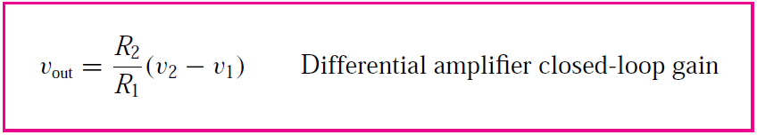
Operational Amplifier - Differential Amplifier

Slide 10
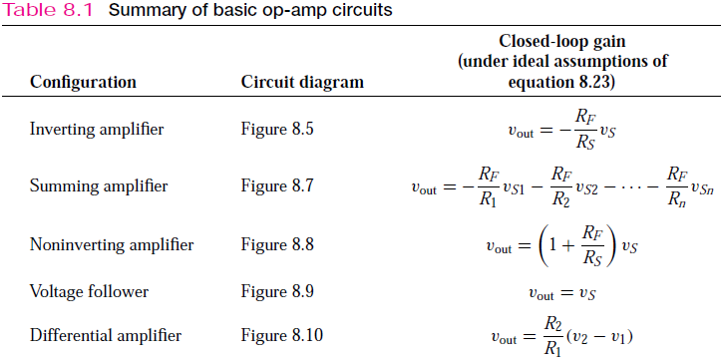
Operational Amplifier - Summary

Slide 11
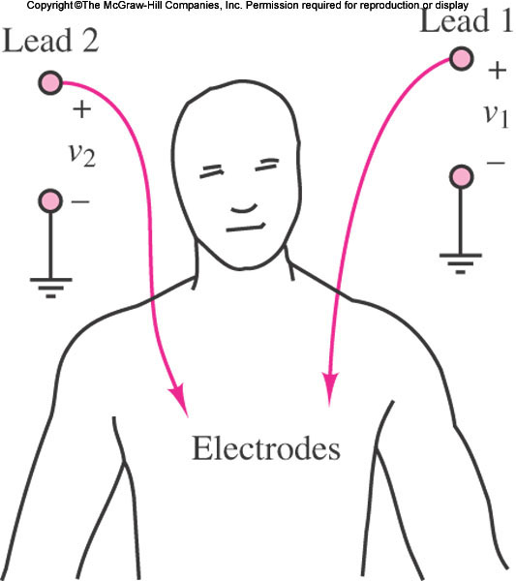
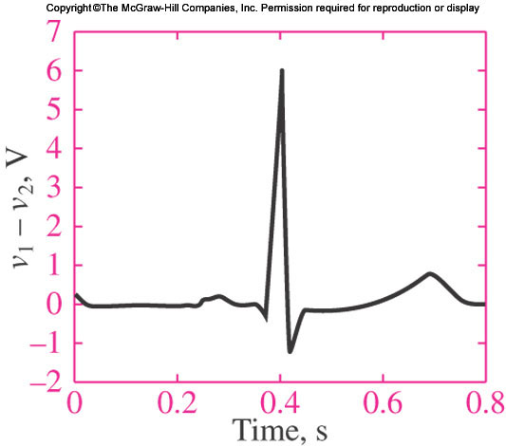
Operational Amplifier - Examples
Ex 8.3 Electrocardiogram (EKG) Amplifier
This example illustrates the principle behind a two-lead electrocardiogram (EKG) measurement. The desired cardiac waveform is given by the difference between the potentials measured by two electrodes suitably placed on the patient’s chest,

Slide 12
Operational Amplifier - Examples

Slide 13
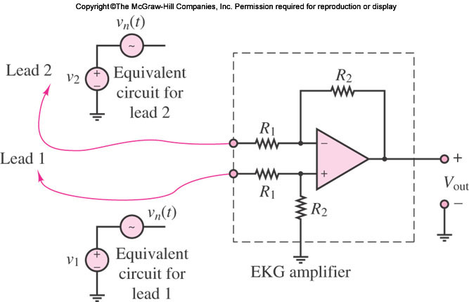
Operational Amplifier - Examples

Slide 14
Operational Amplifier - Examples
In such cases, the differential amplifier provides an invaluable tool in amplifying the desired signal while rejecting the noise.

Slide 15

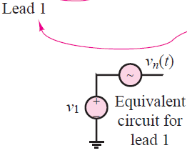
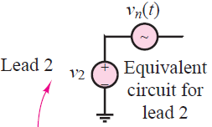

Operational Amplifier - Examples

Slide 16
Operational Amplifier - Examples
In effect, instead of recording the desired EKG signals v1 and v2, the two electrodes provide the following inputs to the EKG amplifier,

Slide 17

Operational Amplifier - Examples
The interference signal
is approximately the same at both leads,
Because the electrodes are chosen to be identical and are in close proximity to each other.
Further, the nature of the interference signal is such that it is common to both leads, since it is a property of the environment in which the EKG instrument
is embedded.
On the basis of the analysis presented earlier, then,

Slide 18
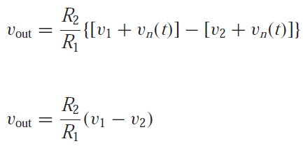
Operational Amplifier - Examples
On the basis of the analysis presented earlier,
then,
or

Slide 19
USING OP-AMP DATA SHEETS
Here we illustrate use of device data sheets for two commonly used operational amplifiers.
The first, the LM741, is a general-purpose (low-cost) amplifier; the second, the LMC6061, is a precision CMOS high-input-impedance single-supply amplifier. Later , we compare the electrical characteristics of these two op-amps.

Slide 20
USING OP-AMP DATA SHEETS
Here we illustrate use of device data sheets for two commonly used operational amplifiers.
The first, the LM741, is a general-purpose (low-cost) amplifier; the second, the LMC6061, is a precision CMOS high-input-impedance single-supply amplifier. Later , we compare the electrical characteristics of these two op-amps.

Slide 21
USING OP-AMP DATA SHEETS
LM741 General Description and Connection Diagrams—This sheet summarizes the general characteristics of the op-amp. The connection diagrams are shown.
Note that the op-amp is available in various packages: a metal can package, a dual-in-line package (DIP), and two ceramic dual-in-line options.

Slide 22
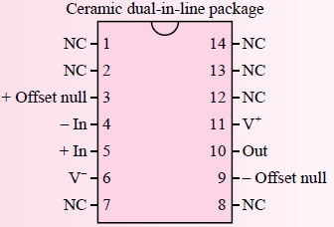
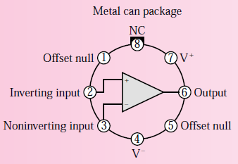
LM741 Operational Amplifier

Slide 23
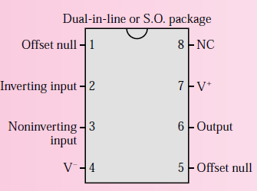

LM741 Operational Amplifier

Slide 24
LMC6061 Operational Amplifier
LMC6061 Precision CMOS Single Micropower Operational Amplifier
The LMC6061 is a precision single low offset voltage, micropower operational amplifier, capable of precision single-supply operation.
Performance characteristics include ultralow input bias current, high voltage gain, rail-to-rail output swing, and an input common-mode voltage range that includes ground.

Slide 25
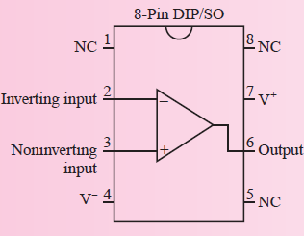
LMC6061 Operational Amplifier
These features, plus its low power consumption, make the LMC6061 ideally suited for battery-powered applications.

Slide 26
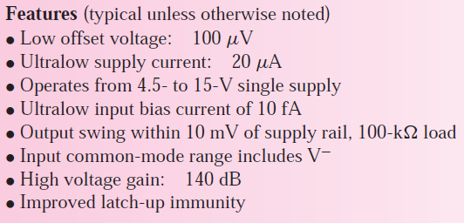
LMC6061 Operational Amplifier

Slide 27
LMC6061 Operational Amplifier

Slide 28
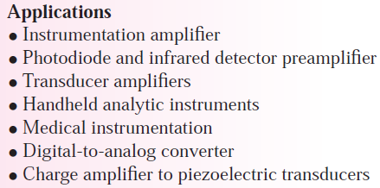
LMC6061 Operational Amplifier

Slide 29
References
Giorgio Rizzoni, “Fundamentals of Electrical Engineering”, McGraw- Hill Education, 2009. ISBN. 978-0-07-338037-7
Peyton Z. Peebles (Author), Tayeb A. Giuma, Principles of Electrical Engineering (Mcgraw Hill Series in Electrical and Computer Engineering), Mcgraw-Hill College, 1991.
Allan R. Hambley, Electrical Engineering: Principles and Applications, Prentice Hall, ISBN-0132130068, 9780132130066, 2011.

Slide 30
Thank you !
Question?

